Slide 1


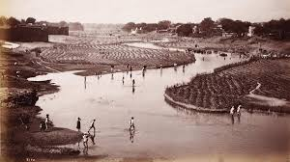
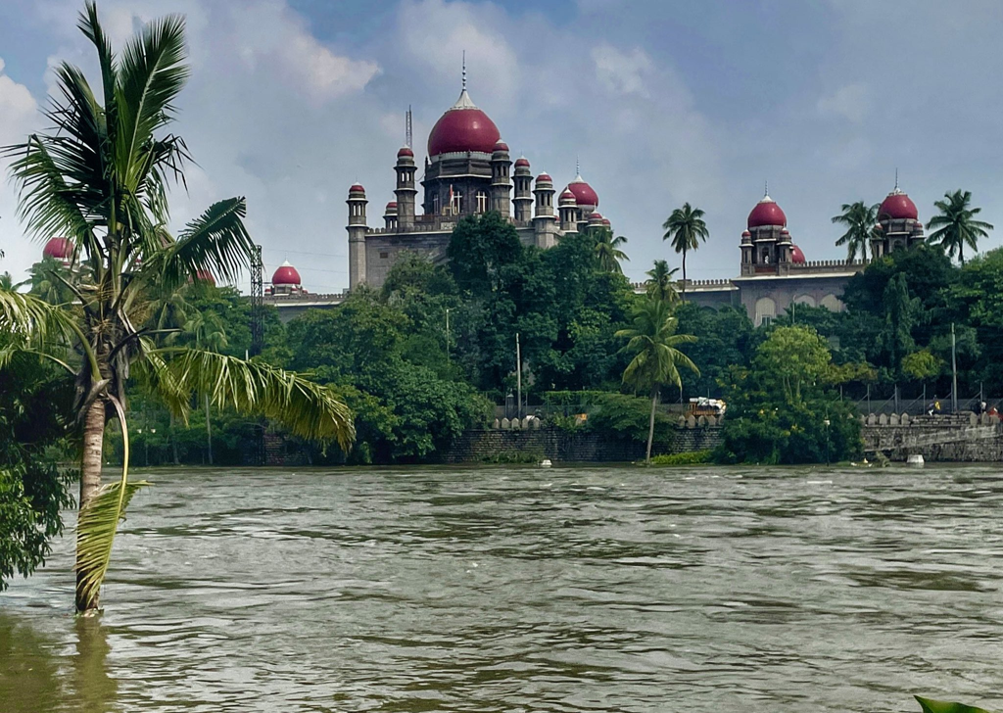
waste Water management - musi river
Gowlapalli Rohit - 2021101113
HYDRO INFORMATICS - INDIVIDUAL ASSESSMENT

Slide 2


CONTENT
01
WATER-RELATED ISSUE
02
DATA COLLECTION
03
CURRENT STATUS
04
INTERVIEW WITH STAKEHOLDERS
05
ANALYSIS
06
POTENTIAL SOLUTIONS
07
CHALLENGES

Slide 3

INDIVIDUAL ASSESSMENT
INTRODUCTION
HYDRO INFORMATICS

Slide 4
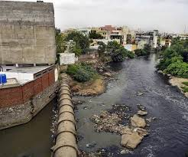
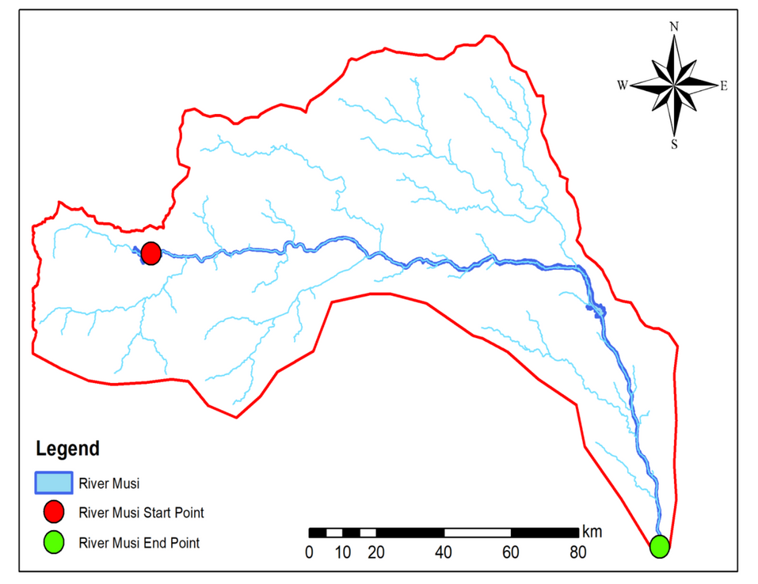
MUSI RIVER
The Musi River originates in the Anantagiri hills and flows into the Osmansagar and Himayatsagar reservoirs, it consists of 2 rivulets Esi (8 kms) and Musa (13 kms) which then converge into Musi River thus being the water sources for Hyderabad for over a century.
The reservoirs were constructed in the Nizam’s reign after devastating floods in 1908. Land around the reservoirs is a Government protected conservation area.
Within Hyderabad, the Musi runs nearly dry. The loss of water is likely to be caused due to the impounding of river water in reservoirs and the degradation of catchment areas. Unchecked urban development and construction over natural rainwater channels and water tanks have disrupted the drainage patterns of the region. Untreated sewage as well as industrial effluents now flow into the river, which is severely polluted

Slide 5
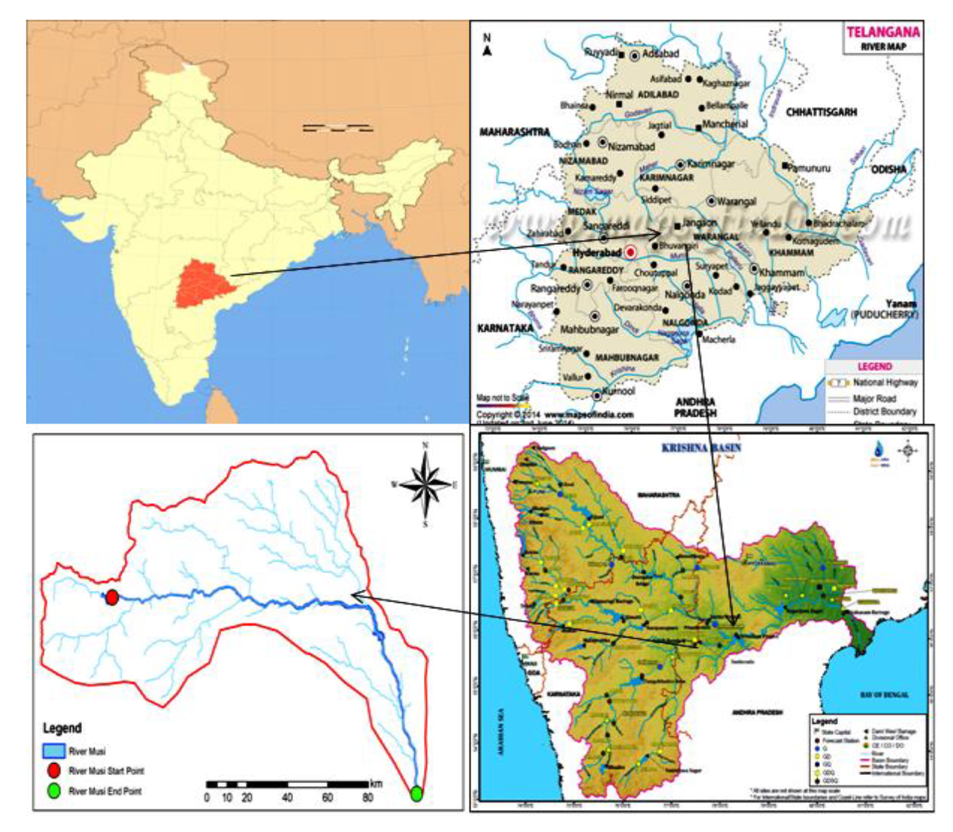

Slide 6
INDIVIDUAL ASSESSMENT
WATER ISSUE
HYDRO INFORMATICS

Slide 7
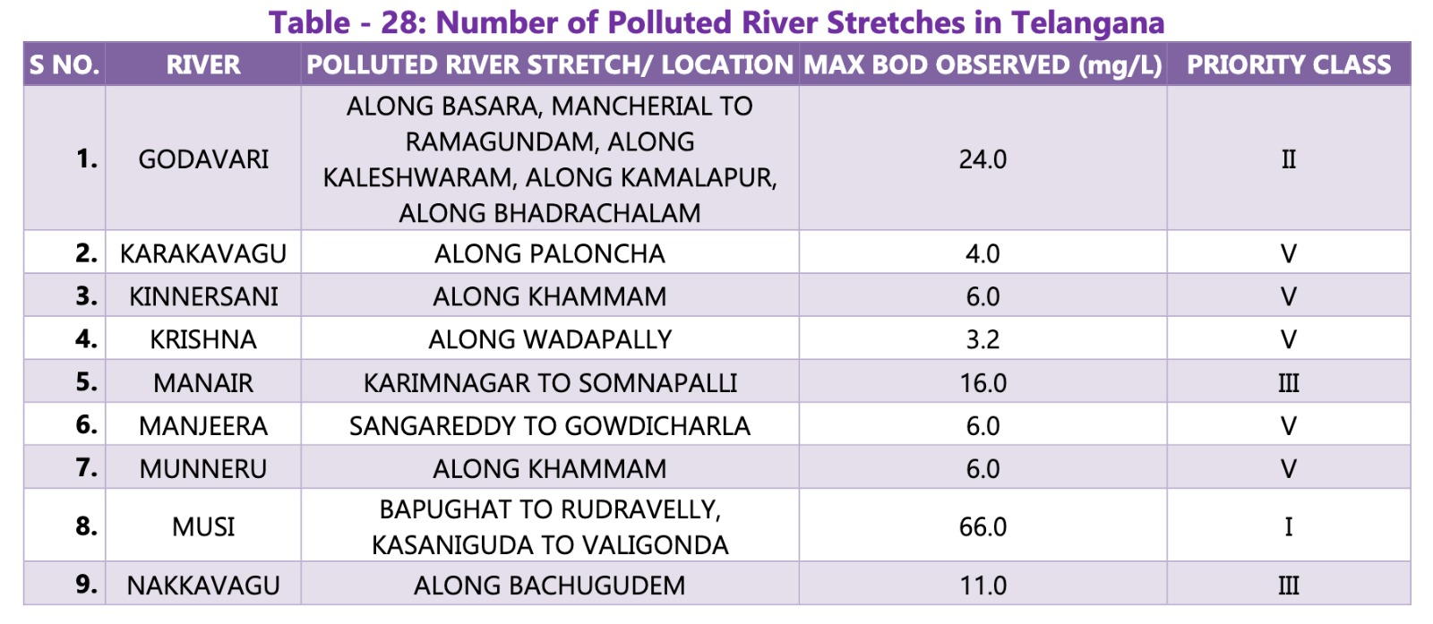


Musi is placed under Priority-I (BOD > 30mg/L) of Polluted River Stretches

Slide 8
MOTIVATION
Ensuring the quality of water resources is essential for safeguarding public health, supporting ecosystem integrity, and sustaining economic activities. The Musi River, a vital water body in our region, faces increasing threats from pollution due to various anthropogenic activities. The deterioration of water quality in the Musi River has significant implications for both human populations and the environment. Therefore, it is imperative to conduct comprehensive assessments of water quality parameters to understand the extent of pollution and devise effective strategies for its management.
OBJECTIVES
Assessment of Water Quality Parameters
Evaluation of Current Waste Water Management Initiatives
Recommendations for Policy and Practice

Slide 9


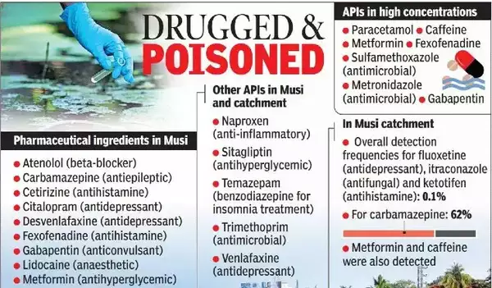


SOURCES OF RIVER MUSI POLLUTION - point sources
INFLUX OF UNTREATED DOMESTIC SEWAGE
TREATED INDUSTRIAL EFFLUENTS FROM CETP’s
PHARMACEUTICAL - CHEMICAL WASTE

Slide 10



CONCERNED WATER ISSUES
01
RIVER WATER qUALITY
02
Waste water manAgement

Slide 11
INDIVIDUAL ASSESSMENT
DATA COLLECTION
HYDRO INFORMATICS

Slide 12

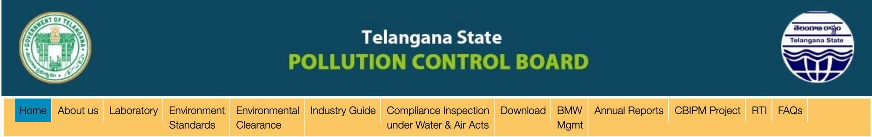
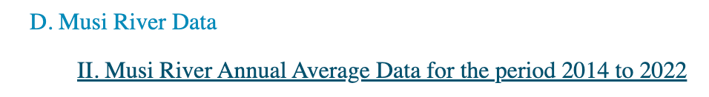
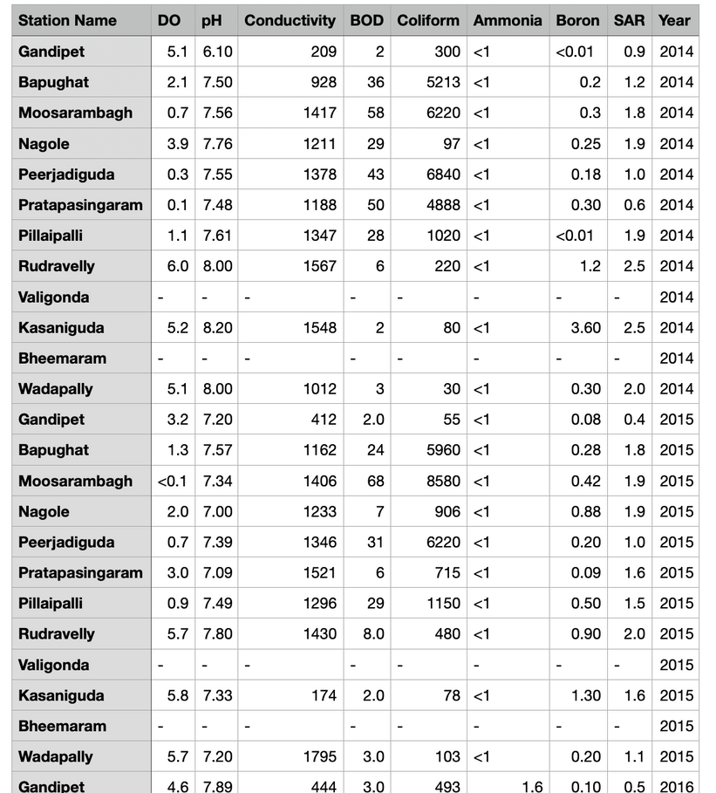

DATA SOURCES
Dissolved Oxygen (DO) - mg/L
Biological Oxygen Demand (BOD) - mg/L
Conductivity - mS/cm
Total Coliform - MPN/100ml
Ammonia - mg/L
Boron - mg/L
SAR - mg/L
pH

Slide 13
12 SAMPLING LOCATIONS FOR DATA COLLECTION
River Musi at Pillaipalli | U/s of Musi at Gandipet (OsmanSagar Lake)
River Musi at Rudravelly Bridge | Musi sample at Bapughat Sangam U/s of Musi
River Musi at Kasaniguda | River Musi at Moosarambagh bridge, Hyderabad
Bheemaram Bridge , Nalgonda District | River Musi at Nagole Bridge
River Krishna at Wadapally | River Musi at Peerjadiguda
River Musi at Valigonda Bridge | D/s of Musi at Pratapasingaram

Slide 14
INDIVIDUAL ASSESSMENT
ANALYSIS
HYDRO INFORMATICS

Slide 15
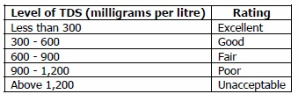
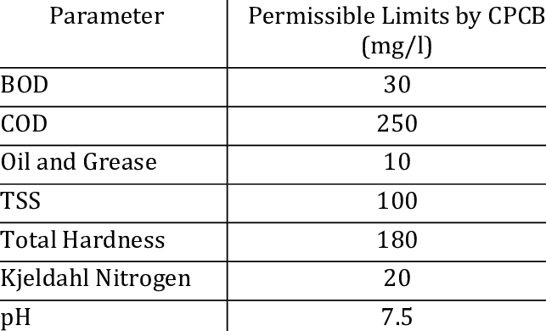
PERMISSIBLE LIMITS

Slide 16
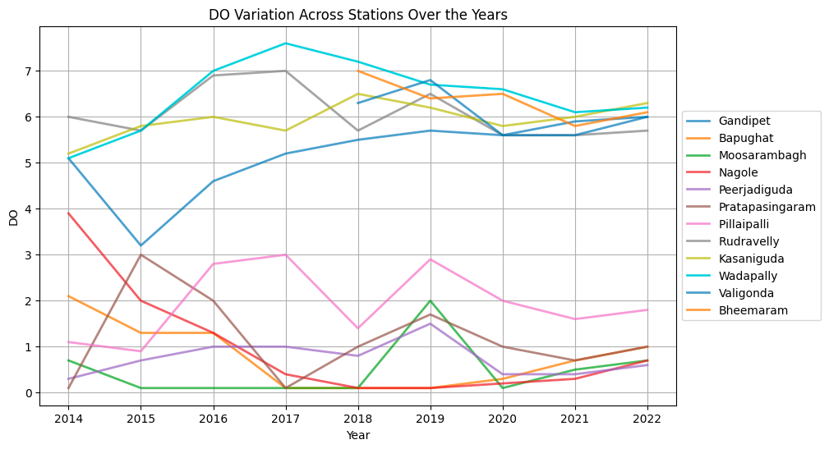
DISSOLVED OXYGEN
Mann-Kendall Trend Test:
Gandipet - Increasing Trend , p-value: 0.002499

Slide 17
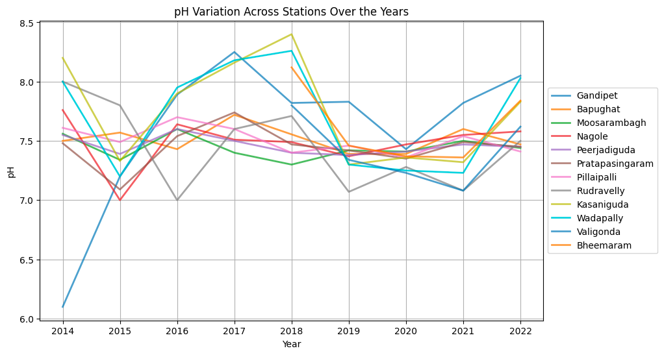
pH
Mann-Kendall Trend Test:
No significant trends were observed

Slide 18
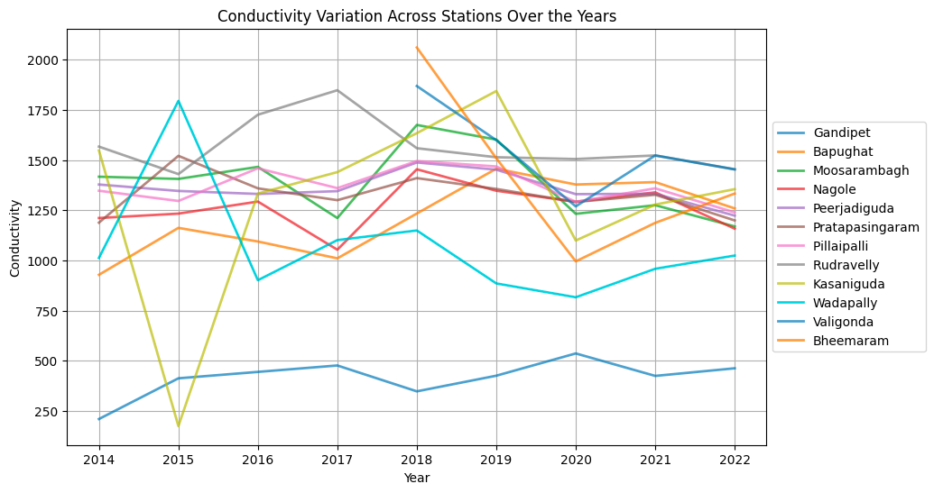
CONDUCTiVITY
Mann-Kendall Trend Test:
Mann-Kendall Trend Test:
No significant trends were observed

Slide 19
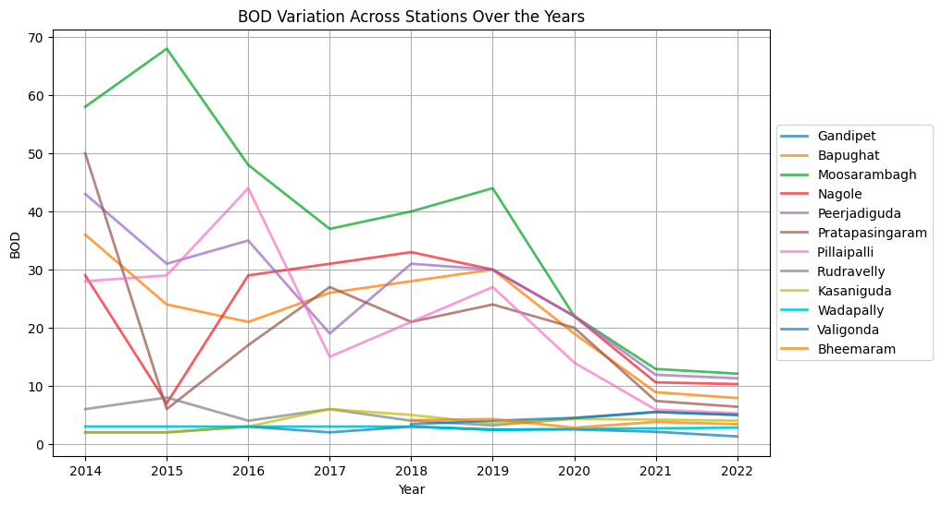
biological oxygen demand
Mann-Kendall Trend Test:
Bapughat, Moosarambagh, Peerjadiguda, Pillaipalli
Decreasing trends with p-value<0.05

Slide 20
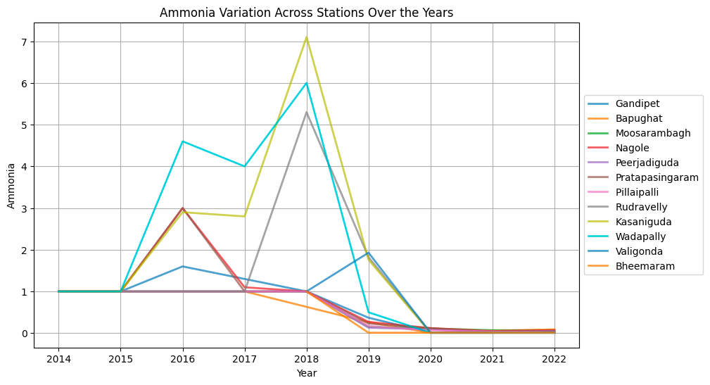
ammonia
Mann-Kendall Trend Test:
Bapughat, Moosarambagh, Peerjadiguda, Pillaipalli
Decreasing trends with p-value<0.05

Slide 21
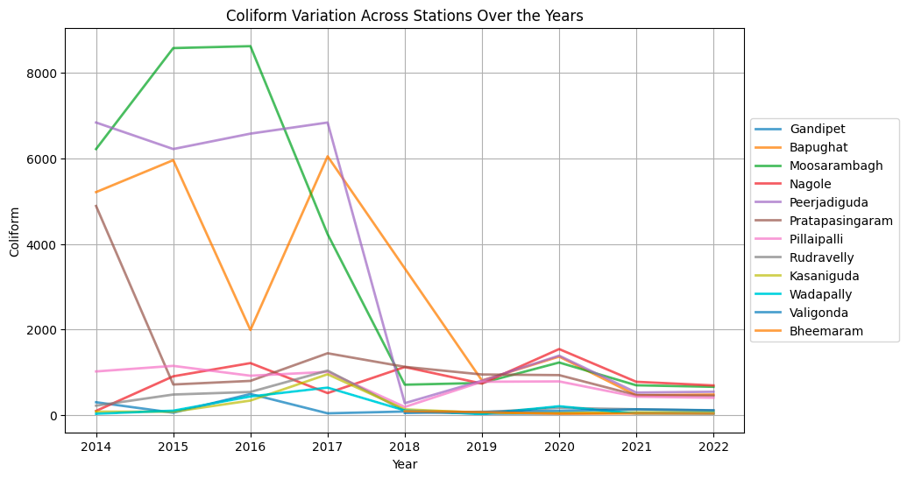
coliform
Mann-Kendall Trend Test:
Moosarambagh, Pillaipalli
Decreasing trends with p-value<0.05

Slide 22
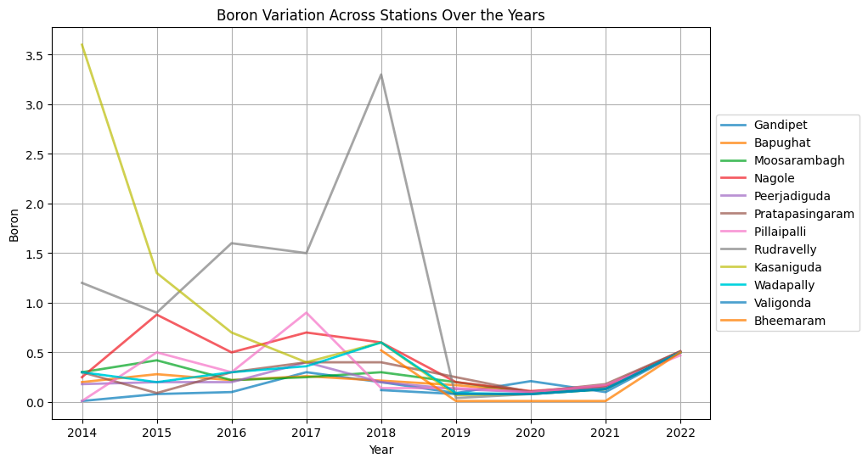
BORON
Mann-Kendall Trend Test:
Kasaniguda - Decreasing Trend , p-value: 0.047604

Slide 23
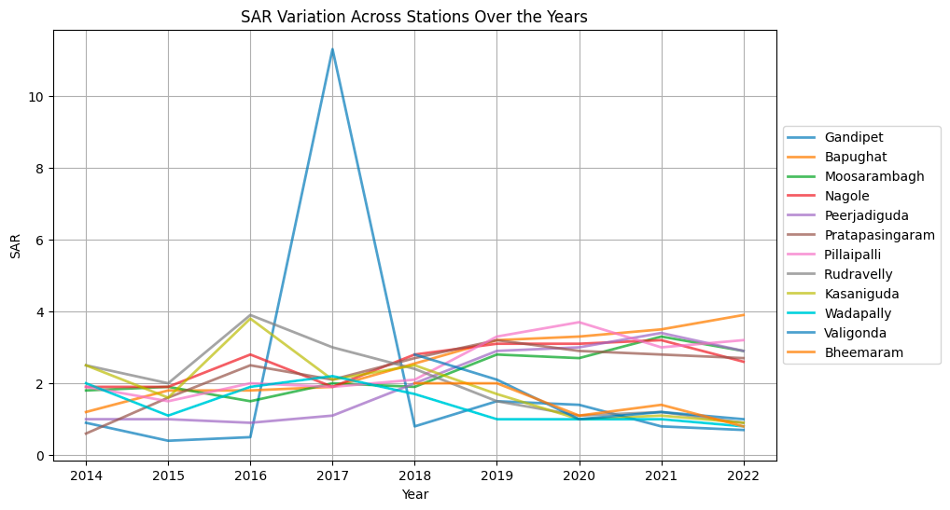
sar
Bapughat, Moosarambagh : Decreasing trends
Mann-Kendall Trend Test:
Kasaniguda, Wadapally : Increasing trends

Slide 24
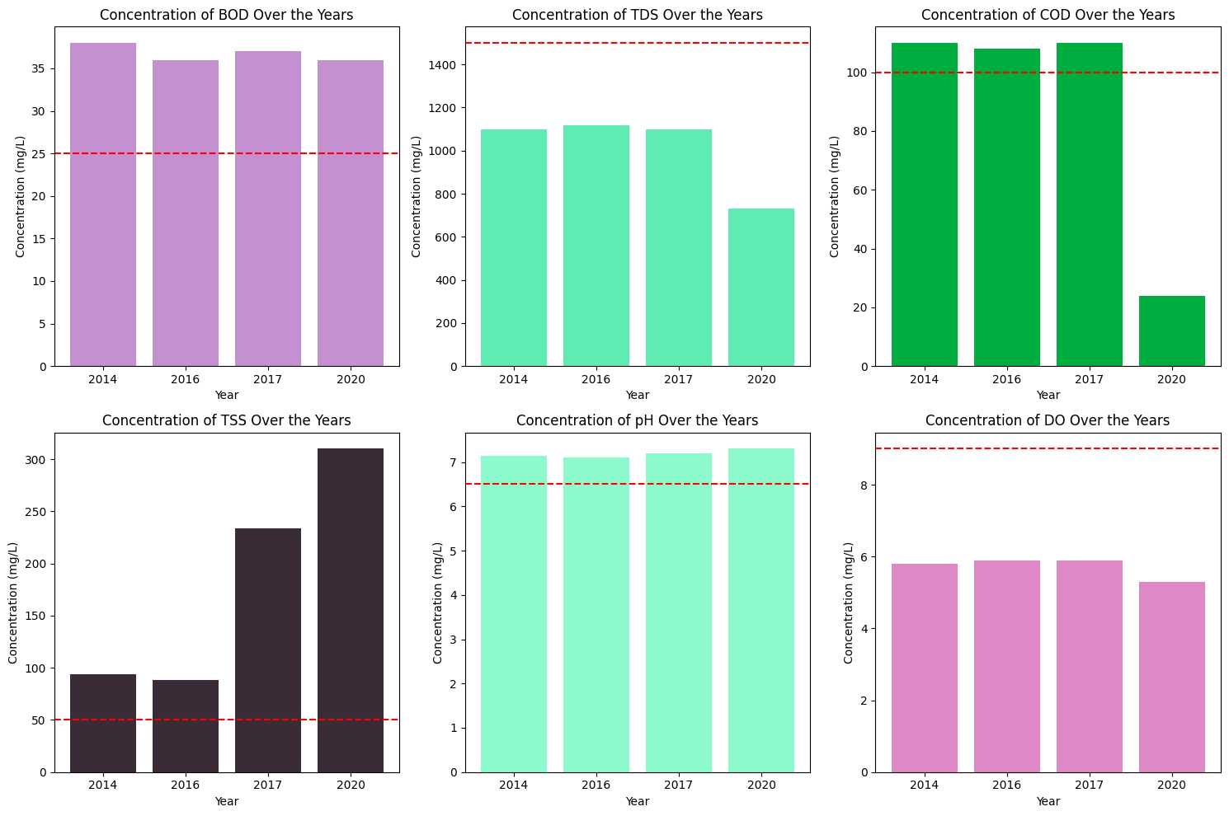
Surface water quality with permissible limits of US-EPA (1992) standards for wastewater reuse

Slide 25
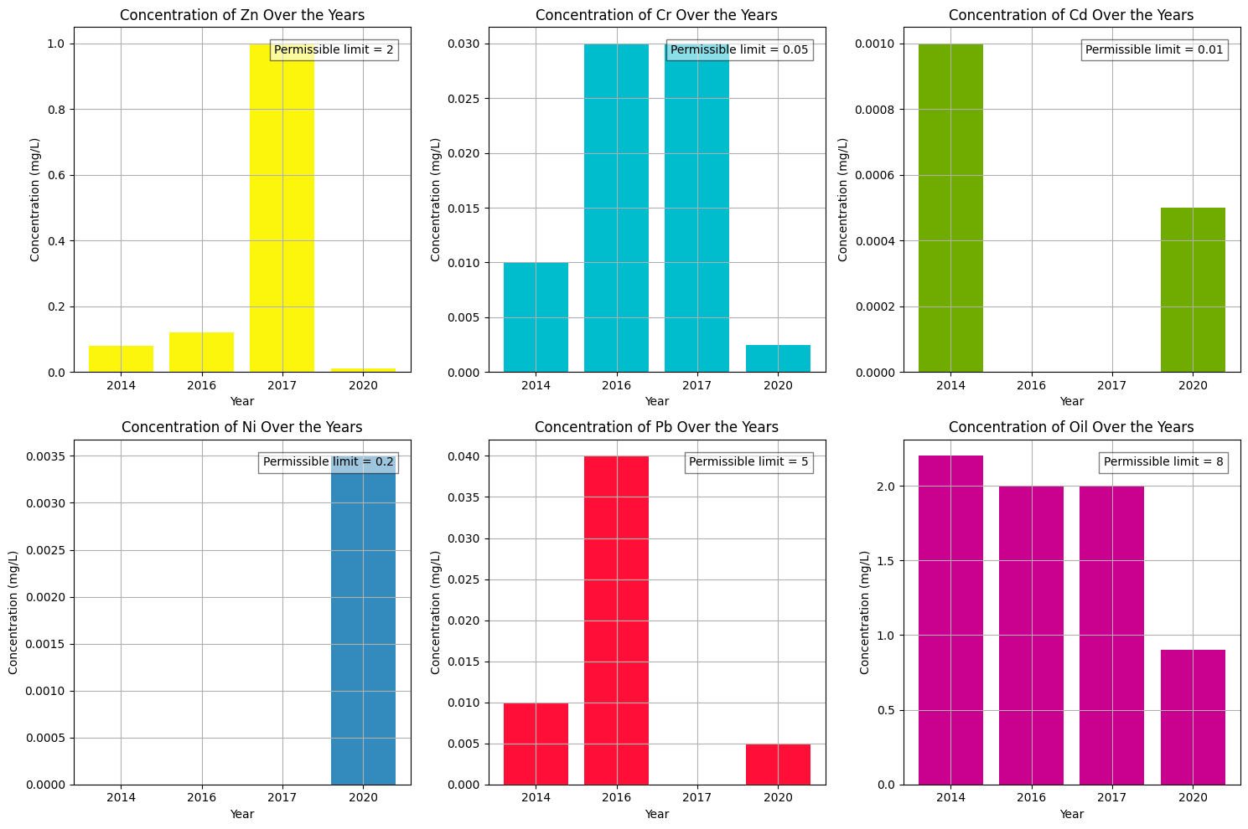
Surface water quality with permissible limits of US-EPA (1992) standards for wastewater reuse

Slide 26
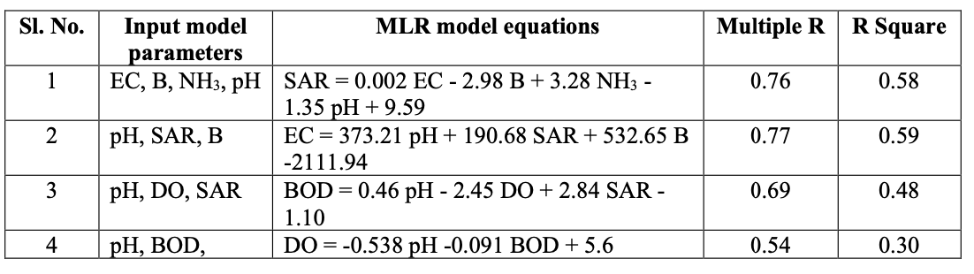
MULTIPLE REGRESSION ANALYSIS
Four MLR models are developed to predict Sodium Adsorption Ratio (SAR), Electrical Conductivity (EC), Biological Oxygen Demand (BOD) and Dissolved Oxygen (DO).
F-tests and t-tests are carried out to measure the goodness of fit of the MLR models developed. F-test determines the significant relation between the dependent variable and the independent variables.

Slide 27
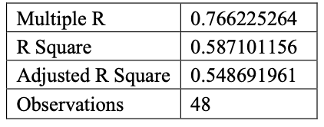
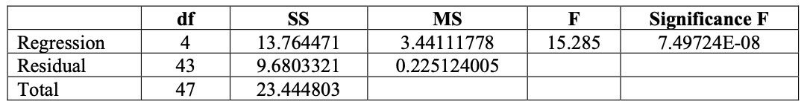
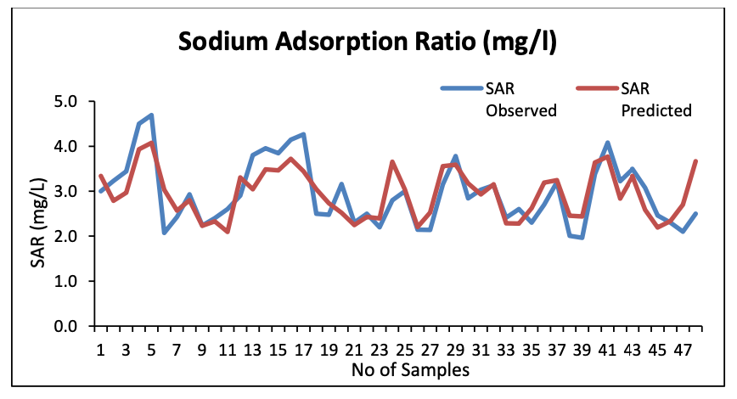
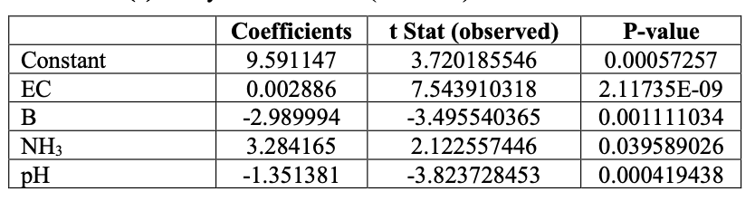
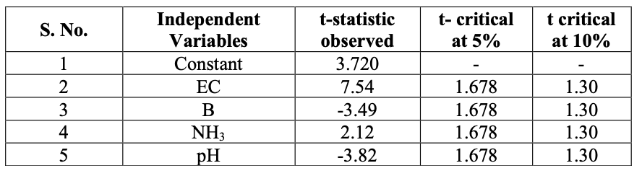
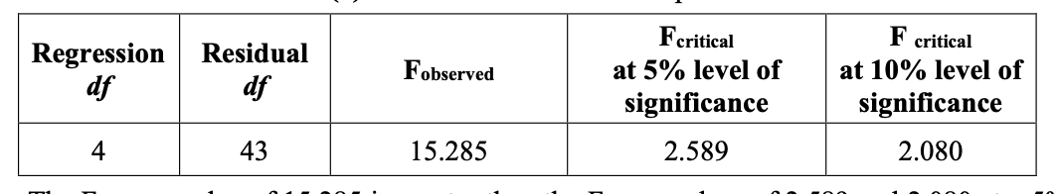
Prediction of Sodium adsorption Ratio (SAR)
SAR = 0.002 EC - 2.98 B + 3.28 NH3 - 1.35 pH + 9.59

Slide 28
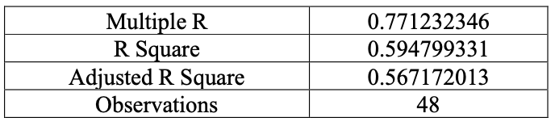
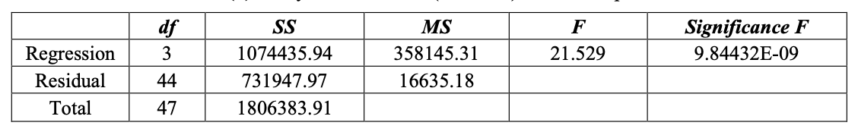
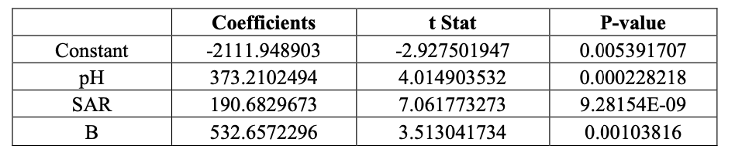
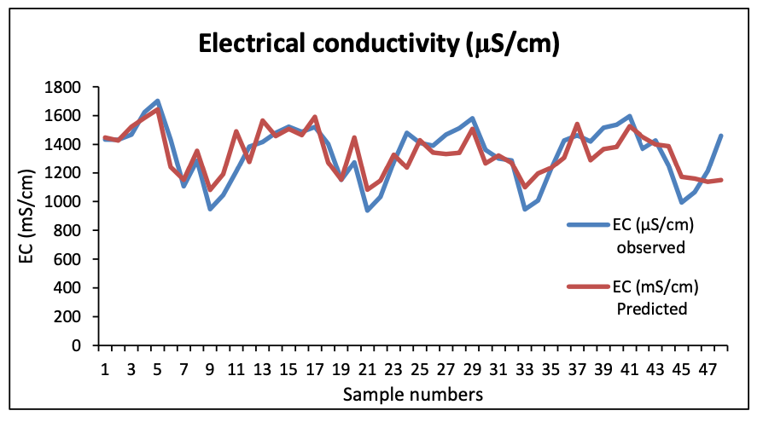
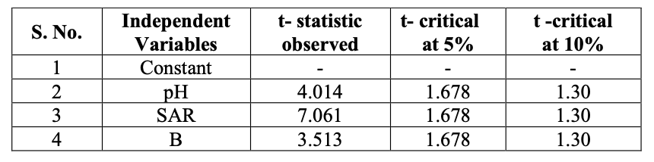
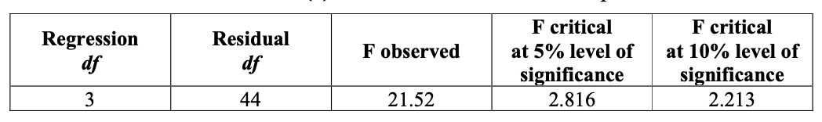
Prediction of Electrical Conductivity (EC)
EC = 373.21 pH + 190.68 SAR + 532.65 B -2111.94

Slide 29
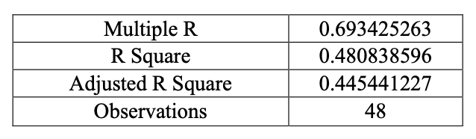
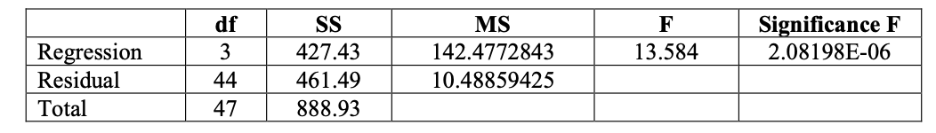
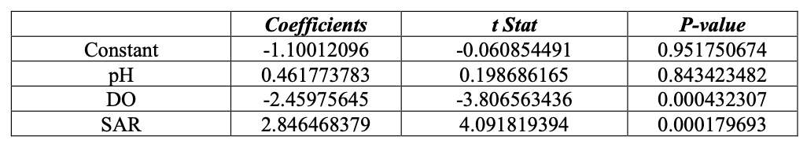
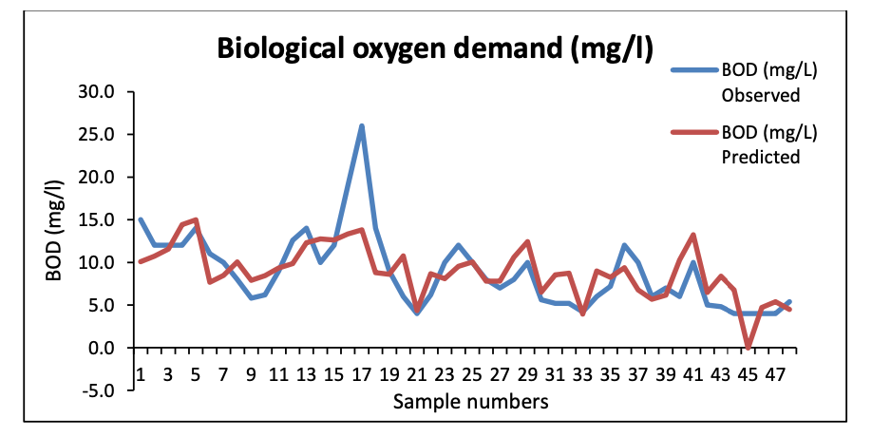
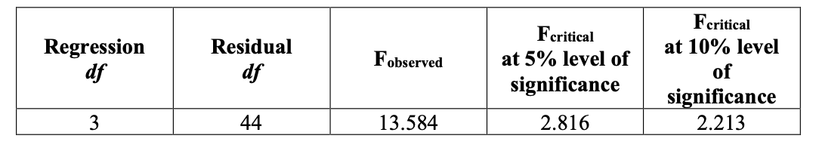
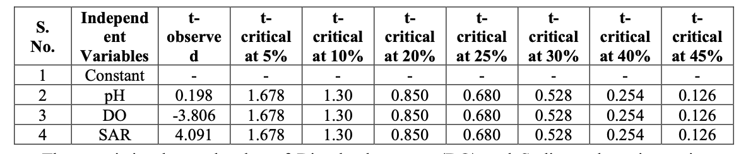
Prediction of Biological Oxygen Demand (BOD)
BOD = 0.46 pH - 2.45 DO + 2.84 SAR - 1.10

Slide 30
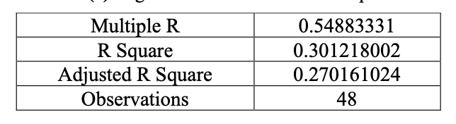
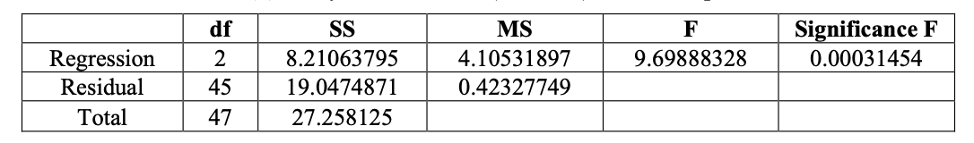
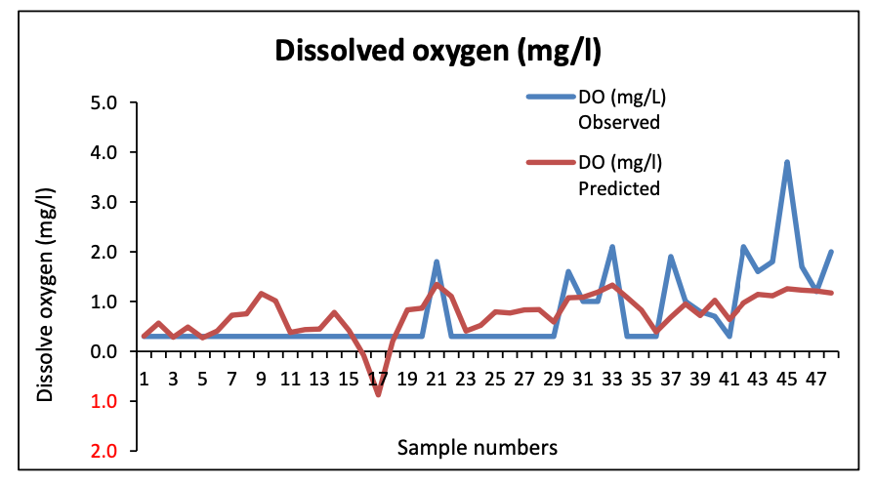
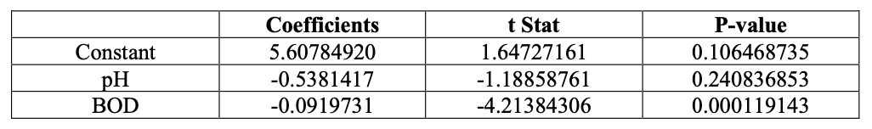
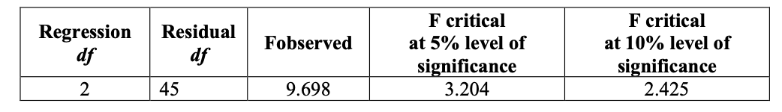
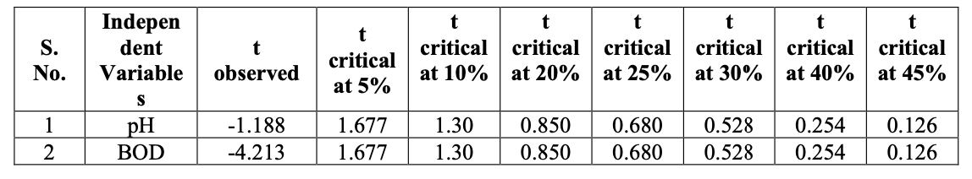
Prediction of Dissolved Oxygen (DO)
DO = -0.538 pH -0.091 BOD + 5.6

Slide 31
INDIVIDUAL ASSESSMENT
CURRENT STATUS
HYDRO INFORMATICS

Slide 32
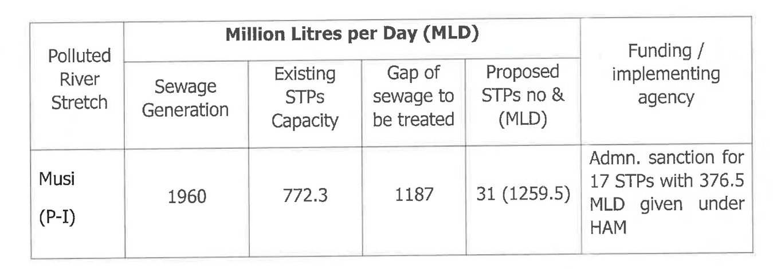
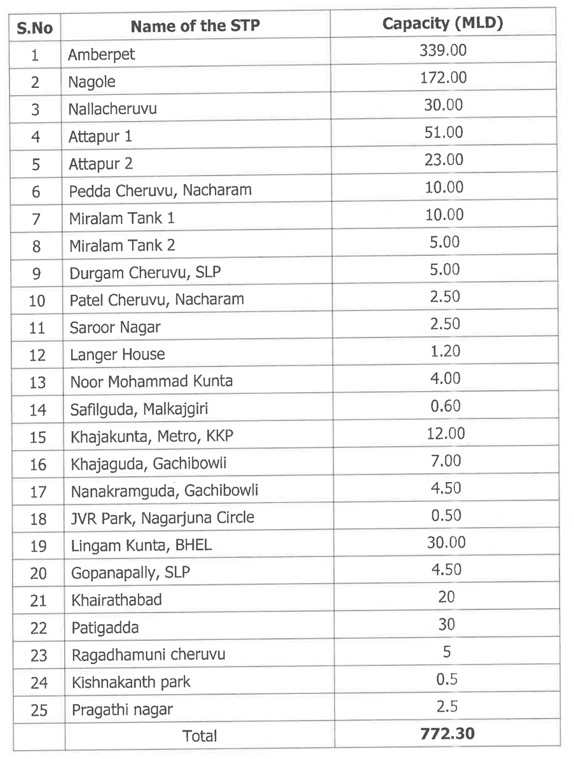
SEWERAGE STATUS AND TREATMENT
HMWSSB engaged M/s Shah Technical Consultants to prepare Comprehensive Sewerage Master Plan in HUA upto ORR limit
The projected Sewage Generation for the year 2021 is 1960MLD out of which the existing treatment capacity available is 772.3MLD
The gap of 1187.7 MLD sewage flows through 185 drains and joins various water bodies which in turn joins River Musi

Slide 33
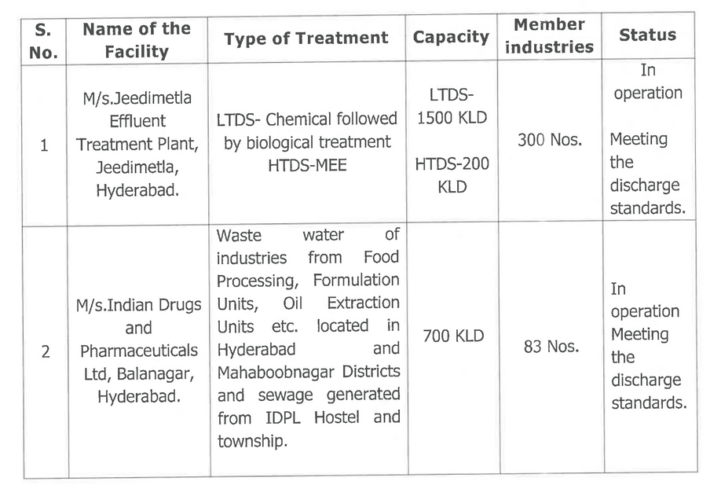

TREATMENT AND DISPOSAL OF INDUSTRIAL EFFLUENTS
In order to treat effluents of various industries in watershed of Musi, 4 common efficient treatment facilities viz. MANA CETP, IDPL, JETL, PETL have been operating to cover different industrial clusters in the Hyderabad city.
The CETPs have installed the OCEMS and are connected to the CPCB and TSPCB servers
The treated wastewaters from CETPs are further being treated along with domestic sewage in STPs.
The treated sewage from STPs is being disposed into Musi River, after meeting the standards

Slide 34
INDIVIDUAL ASSESSMENT
SURVEY
HYDRO INFORMATICS

Slide 35



INTERVIEW WITH STAKEHOLDERS

Slide 36
INDIVIDUAL ASSESSMENT
INITIATIVES TAKEN
HYDRO INFORMATICS

Slide 37

ACTION PLAN
Restoration of Musi River

Slide 38
INITIATIVES - ACTION PLAN
01
NEW sewage treatment plants
02
in-situ treatment
03
co-treatment of septage at existing stp’S FOR ORR AREAS
04
FAECAL SLUDGE TREATMENT PLANTS at proposed stp sites
05
installation of ocem’S AT ALL EXISTING STP’s
06
river-front activities
07
removal of encroachments

Slide 39

SEWAGE TREATMENT PLANTS
The Government has accorded administrative sanction for one package for construction of 17 STPs with a capacity of 376.5 MLD
IN-SITU TREATMENT
HMWSSB has identified a gap of 1174 MLD of sewage flowing through 185 drains to water bodies.
They have issued a work order for preparation of a DPR for in-situ remediation of drains leading to the river Musi.
HMWSSSB has submitted a proposal of Rs.528.30 Crores for taking up in-situ remediation of 1174 MLD sewage at Rs.45 Lakh per MLD to Government.

Slide 40


Slide 41

MUSI RIVER REVITALIZATION PROJECT

Slide 42
INDIVIDUAL ASSESSMENT
POTENTIAL SOLUTIONS
HYDRO INFORMATICS

Slide 43


POTENTIAL SOLUTIONS
Removal of Juliflora,Shrubs and Silt for free flow of River without Stagnation
Removal of Water Hyacinth at Ziaguda
Clearing Debris & Shrubs between Salarjung Bridge to Chaderghat Bridge which could potentially avoid Floods
Storm-water Management
Community Engagement and Awareness
Source Control Measures
Ecological Restoration

Slide 44
INDIVIDUAL ASSESSMENT
CHALLENGES
HYDRO INFORMATICS

Slide 45

CHALLENGES
Water contamination : Slums and informal settlements lack adequate sanitation infrastructure and waste from these settlements flows into the river through storm water drains. The sources of industrial effluents are difficult to track, as informal industries are scattered through the city. It is difficult to monitor or enforce regulations and they may be costly and burdensome for informal sector firms.
Laws and Regulations: While India has fairly strong environmental conservation laws and regulations at the national, state and municipal level, including the Environment Protection Act, 1986 and the Water Act, 1974, enforcement is weak. Unauthorized construction activities are rampant, as enforcement capacity is limited
Slum Communities and Livelihoods: Poor migrants lack access to formal housing & land and typically settle on marginal or public lands such as riverbanks. The challenge is to minimize the loss of homes and livelihoods and balance environmental protection and sustainability concerns with the welfare of the city’s poor and vulnerable.
The Road: An elevated road linking the Eastern and Western ends of the extended Hyderabad metropolitan area is a core element of the Government’s requirements for the Musi River Corridor.The challenge is to the integrate the critical transport component with the larger vision for a sustainable, revitalized Musi River

Slide 46
INDIVIDUAL ASSESSMENT
THANK YOU
HYDRO INFORMATICS

